Slide 1

KHATRA ADIBASI MAHAVIDYALAYA
E-CONTENT
DEPARTMENT OF EDUCATION
SEMESTER-V (PROGRAMME)
SESSION: 2020-21
SUBJECT: EDUCATION
COURSE TITLE: DEVELOPMENT OF EDUCATION IN INDIA
COURSE CODE: AP/EDN/401C-1D
TOPIC: WOOD’S DESPATCH
NAME OF THE TEACHER: AKINCHAN PAL

Slide 2
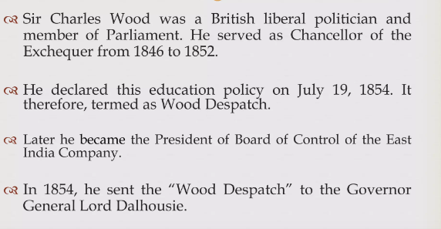
Wood’s Despatch

Slide 3
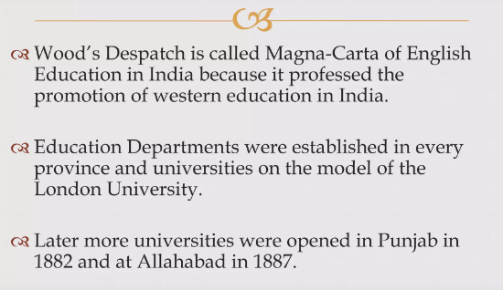
Effects of Wood’s Despatch

Slide 4
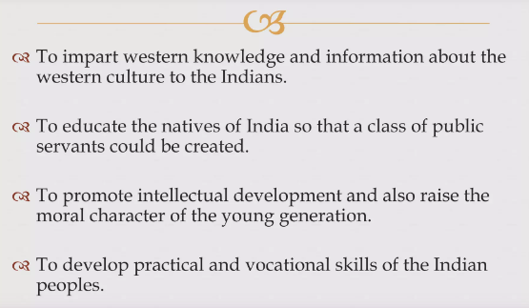
Objectives of Wood’s Despatch

Slide 5
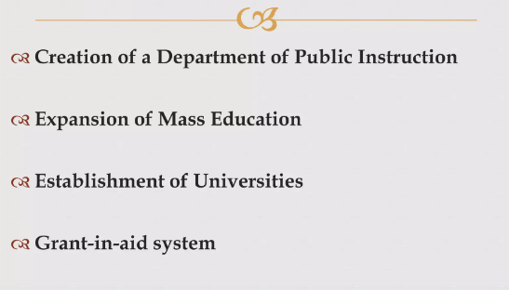
Recommendations

Slide 6
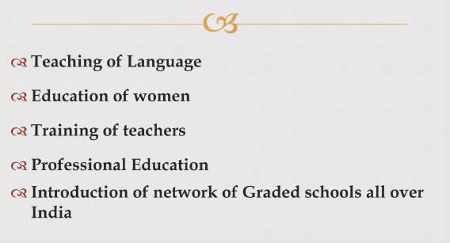
Recommendations

Slide 7
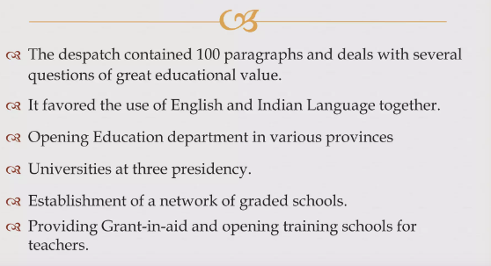
Importance

Slide 8
THANK YOU

